Slide 1
Introductions
Instructor: Kasun Samarsinghe
Sr. Data Scientist, Device Authentication and Identification, American Express
Background: Security in Fintech and e-Commerce
Hobbies: Biking and Hiking
Introduce yourself!!
Your Department and year/ quarter
Past data related experience – aspirations
Hobbies

Slide 2
Group Work
Assignments should be completed as group work and each group should have at least 4 students each
Exceptions will be given for 3 student groups predicated on the class size
Please make sure that each individual group member is contributing towards assignments and the final project
Once a group is formed, one member of the group should email me with group member names;
Each group should submit 1 report (with the code) for assignment work
Every report should contain all group member names
Group work will be assessed during the 4 Assignments and the Final Project
Data selected for Assignment1 can be used for later Assignments and the Final Project
Choose a dataset with high cardinality, variability, diversity of data types, larger size etc…
Week 5 will be an in-class Quiz – will be individually assessed
Discussion: Initial posting, end of Day 3 (11:59 PM, ET). Secondary posting, to at least 2 of your classmate's postings by the end of Day 7 (11:59 PM, ET).

Slide 3
How do we get started
Collection of data can be explained in two main methods
Descriptive statistics – Take a sample/ group and record statistics such as mean, median etc. for that group
Inferential statistics – Select a representative sample from a population and derive inferences about the larger population’s statistics
Where can we find the data:
Google dataset search: https://datasetsearch.research.google.com/
data.world - https://data.world/
Github/ Kaggle -
Scarping websites and via API
Industry
Database: SQL, NoSQL, Oracle, MongoDB, Cassandra
API calls – time consuming, resource extensive
Colleague: local files (using SFTP)
Web scraping: running a JS over the website to scrape web data (Eg: urllib and beautifulsoup)
AWS: S3 buckets, DynamoDB, SimpleDB

Slide 4
What is the structure of your data?
How Much Of A Mess Is Your Data?
Is The Data Structured?
Structured data: Database – Primary Key, Secondary and Composite Keys are pre-defined
CSV – schema is pre-defined
Unstructured Data:
JSON - schema can change over the data points
XML
Parquet
What is the difference between JSON and Parquet file formats?
JSON is easier to write, but takes a longer time to read compared to Parquet
Text
Should be parsed using pre-defined dictionaries to make sense out of the data

Slide 5
Data Cleanup and Pre-Processing
Data Scientists, typically spend 50% of their time on cleaning and understanding the data
Important to understand the data dictionary and the problem domain
What Do We Need To Look For
Missing Values
Anomalies
Duplicates
Typos
Class Imbalance – Fixed by Over sampling, Under sampling, Synthetic sampling (SMOTE)
Type Conversion
Variables can be of type: Numerical, Categorical, Ordinal, Date, Character etc.
5 – Could be a numerical, categorical or ordinal variable – convert to the correct type based on the data
2018-01-05 – Convert this to a date type
R has as.factor, as.numeric, as.Date functions that help type conversions
??What is the difference between Data Engineers and Data Scientists

Slide 6
Missing Values: How to handle them?
Most real-life data is not complete
The missing data should be handled in such a way that it doesn’t affect the credibility of the data and the model concept
Most tree based models can handle missing data
Techniques:
Given missing at random, If the missing value rows are ~0-0.5% - remove the examples
Given missing at random, If the missing values rows are ~0.5-20% - replace with mean (normally distributed)/ median(imbalanced data)
Before removal validate normal behavior in the variable that has missing values
Use Maximum Likelihood/ EM algorithm to estimate the missing values based on a multivariate normal distribution and conditional probability
Encode the missing values to be -1, -99999 for tree based models
Impute missing values using predictive models or clustering – k Nearest Neighbors Imputer
Replace NA’s with 0
Multiple imputation using linear regression and central limit theorem

Slide 7
Anomalies (Outliers/ Novelties)
Observations that are outside of the general distribution of the normal observations
Outlier detection: Detecting deviant observations when training data is polluted with outlier observations – Eg: Multivariate Gaussian Distribution
Novelty detection: Training data is not polluted and detecting whether a NEW observation is an outlier or not – Eg: 1-class SVM
Extraneous values in a numerical variable can be detected using
Observations that are outside of certain factors of the std. deviation
Boxplot
Text based anomalies
Misspellings, case sensitives, white spaces, date conversions etc.
Before modeling, outliers should be removed from the dataset

Slide 8
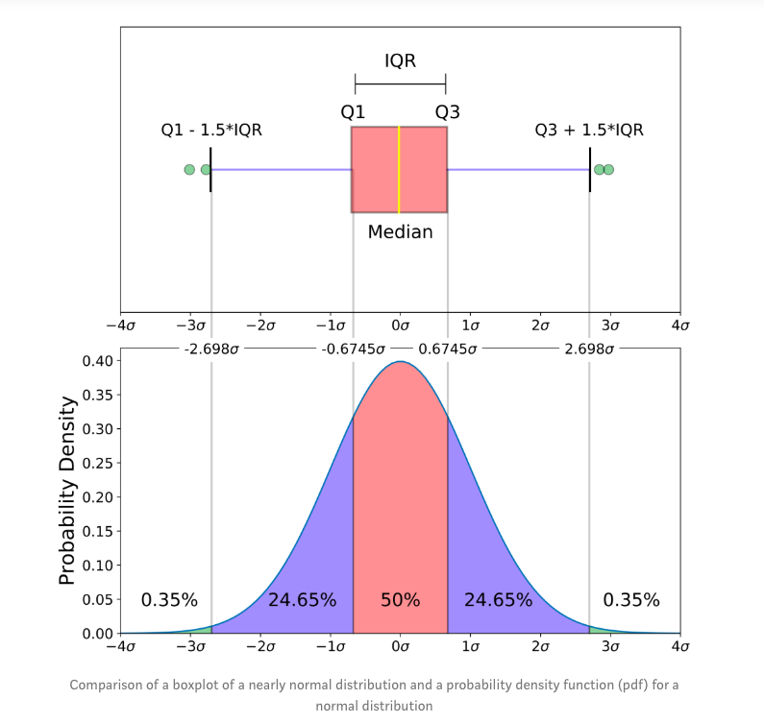
BoxPlot
IQR: Inter quartile range: Q3 – Q1
“maximum”: Q3 + 1.5*IQR
“minimum”: Q1 - 1.5*IQR
Observe that the outliers are all the observations that are outside of the maximum and minimum points
Source: https://towardsdatascience.com/understanding-boxplots-5e2df7bcbd51

Slide 9
Exploratory Data Analysis: EDA
Processed cleaned data can now be analyzed
Summary statistics: Mean, Median, Mode, Frequency Distribution
Correlation matrix – relationship between variables
Use summary(data) function in R
Central Limit Theorem
Visualize your findings
Single Variable
Histograms/ Frequency plots
Boxplots/ Outlier Analysis
Correlation plots – Time series
Density or line charts
Multiple Variables
Scatter plot
Heatmap
Stacked bar charts

Slide 10
Improving the data
Always use business acumen and domain knowledge in creating new variables
Convert epoch time in to hh:mm Y:M:D
Use epoch time to create a weekday/ weekend column
Combine multiple variables to form a new predictive variable
Adhere to compliance and privacy restrictions of the data set by the region, industry and your company
Explore other sources of data to supplement your current modeling exercise
Use independent weather data from publicly available APIs
Use publicly available zipcode information to tie with city and states
Use publicly available traffic information to supplement traffic analysis
If the cardinality(number of unique values) is high for a variable
Use the hashing trick
Use binning

Slide 11
Simulation work in R
Quick intro to R
OOD – NEU Discovery Cluster
EDA in R
Break – 5-10 mins

Slide 12
Group Work
Open Up The Dataset In Course Materials ->Supporting Material->Clean Data
Go Through The Steps That We Went Through Today
Present at 8:15
What You Cleaned Up
Basic Profile Of The Data
Any Interesting Insights

